Slide 1


Chat Application and Website
Task - 2

Slide 2


Chat application and website
The development of this project centered on the development of a message protocol that would allow the application to properly log in users, send messages, and perform system maintenance.
LMS USERNAME | NAME | BATCH
2115a624 | Vijayaraghul.G | A6
2115a625 | Vimal Raj.D | A6
2115a627 | Vishwa.R | A6
2115a614 | Teja.B | A6

Slide 3


Task-2
CreatevariousFront EndPrograms
Draw anddesignauniform front endcodefor calculator
Draw and design ainteractive front end code fortext-editor
Evaluation Metric:
100%Completion of the abovetasks
Learning Outcome
Get to know about conceptsof project bucketing
Knowing about various frontend development framework likeangular, vue,react
Know aboutvariousreact topicslike components, props,state,life cycleetc.

Slide 4
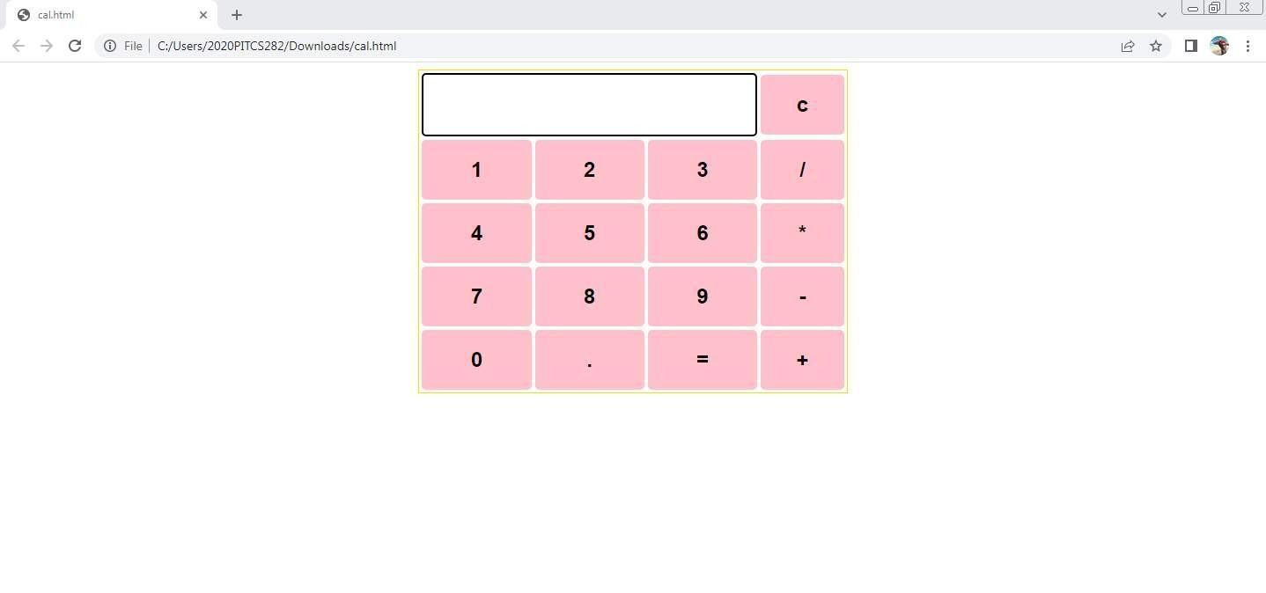
Past calculator output here

Slide 5
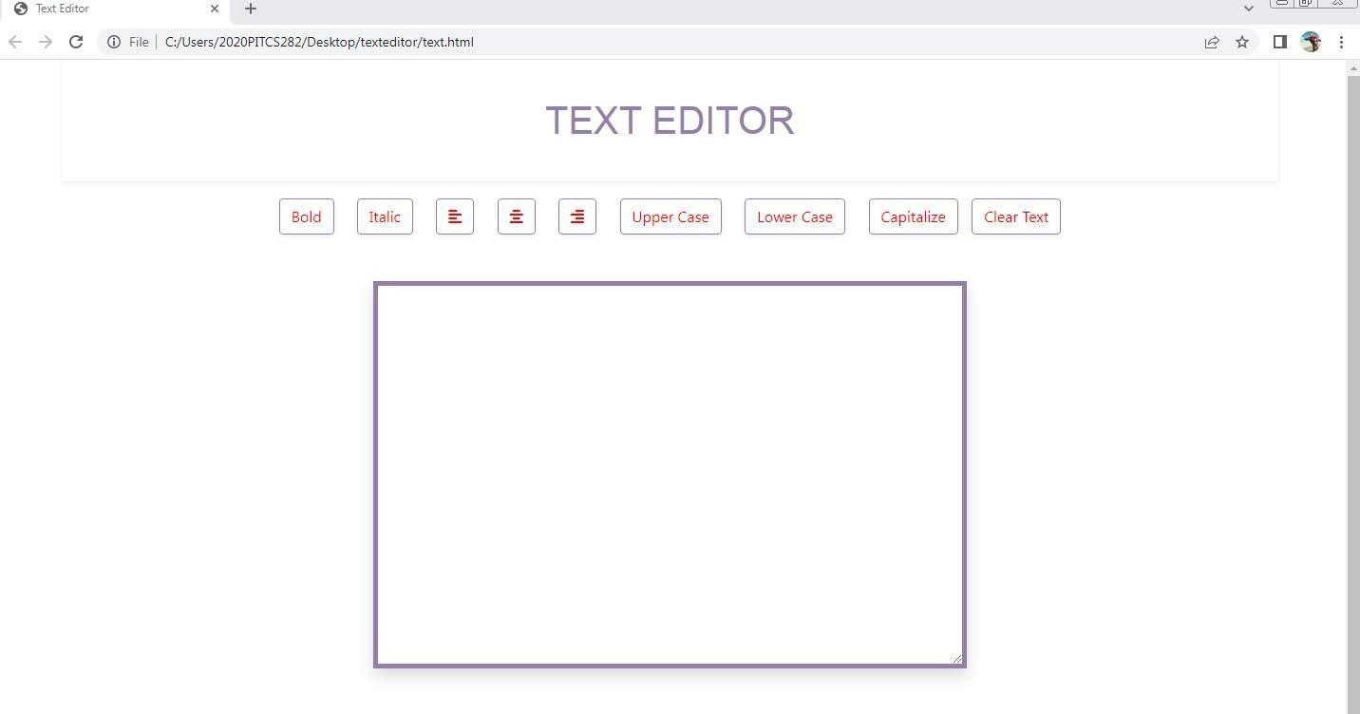
Past text editor output here

Slide 6


AssessmentParameter
Setup Project forCalculator
project
Setup basic structure oftext- editor project
Create amain component with the outer structure of calculator
Check-List
Create main component with all featurebuttons
Create abutton component
with on clickhandler
Create ajson object to store
datafor texteditor
Create a`evaluateExpresion` function to evaluatevalue
Push both code togithub

Slide 7
https://github.com/VIJAYARAGHULG/fullstack

Slide 8


